Slide 1
Prediction of View Growth on Youtube
Chelsea Chen, Wei Kong, Xiaoshu Luo

Slide 2
Data preprocessing

Slide 3
Model selection
Ridge, Lasso, Randomforest, Bagging
70-30 training-validation based on the 34 predictors. CV and OOB
A potentially positive relation between accuracy and number of predictors during each split
Algorithms | Training RMSE | Validation RMSE
Ridge | 0.80 | 1.62
Lasso | 0.82 | 1.61
Randomforest | 0.61 | 1.52
Bagging | 0.59 | 1.47

Slide 4
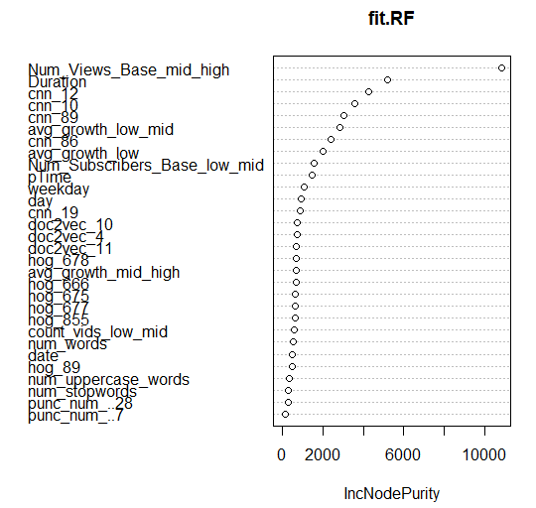
Model performance
RMSE on Kaggle is 1.39065/1.40951
Predictors:

Slide 5
Conclusion

